Slide 1
Database Systems
Schema Refinement
(Normalization)

Slide 2
Outline
Informal Design Guidelines for good Relation Schemas
Formal concepts of Functional Dependencies and Normal Form
1 NF (1st Normal Forms)
2 NF (2nd Normal Forms)
3 NF (3rd Normal Forms)

Slide 3
Introduction
Relational database design: The grouping of attributes to form “Good" relation schemas
Two levels of relation schemas:
The logical "user view" level
The storage "base relation" level
Design is concerned mainly with base relations
What are Criteria for "good" base relations?
Informal guidelines for good relational design
Formal concepts (Normalization) of functional dependencies and normal forms 1NF 2NF 3NF

Slide 4
Informal Design Guidelines For Relation Schemas
Making sure attribute semantics are clear
Reducing redundant information in tuples
Reducing NULL values in tuples
Problems that occur in poorly planned, unmormalized DB where all the data is stored in one table (a Flat File database) is called anomaly

Slide 5
Informal Design Guidelines For Relation Schemas
1. Semantics of the Relation Attributes
Whenever attributes are grouped to form a relation schema, it is assumed that attributes belonging to one relation have certain real-world meaning and a proper interpretation associated with them.
In general the easier it is to explain the semantics of the relation, the better the relation schema design is.
Guideline 1: Design a relation schema so that it is easy to explain its meaning.
Do not combine attributes from multiple entity types and relationship types into a single relation.
3

Slide 6
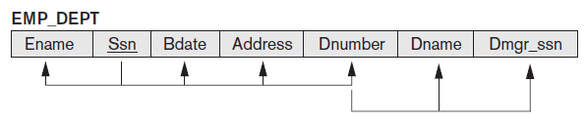
Informal Design Guidelines For Relation Schemas
Example of violating Guideline 1:
A tuple in the EMP_DEPT relation represents a single employee but:
Includes additional information, (Dname) of the department for which the employee works and (Dmgr_ssn) of the department manager.

Slide 7
Informal Design Guidelines For Relation Schemas
2. Redundant Information in Tuples and Update Anomalies
Redundancy: Duplication of data to be stored in database
Grouping attributes into relation schemas has a significant effect on storage space.
One goal of schema design is to minimize the storage space used by the base relations.
Mixing attributes of multiple entities may cause Redundancy
4

Slide 8
Informal Design Guidelines For Relation Schemas
2. Redundant Information in Tuples and Update Anomalies
DNUMBER
DNUMBER, DNAME and DMNGRSSN is repeating group for employee working in same department
5

Slide 9
Informal Design Guidelines For Relation Schemas
2. Redundant Information in Tuples and Update Anomalies
Redundant information may cause update anomalies.
Update anomalies:
Insertion anomalies
Deletion anomalies.
Modification anomalies.
7

Slide 10
Informal Design Guidelines For Relation Schemas
2. Redundant Information in Tuples and Update Anomalies
EMP_PROJ
Insertion Anomalies:
Occurs when it is impossible to store a fact until another fact is
known.
Example:
Cannot insert a project unless an employee is assigned.
Cannot insert an employee unless he/she is assigned to a project.
SSN
PNumber
Hours
EName
PName
PLocation
8

Slide 11
Informal Design Guidelines For Relation Schemas
2. Redundant Information in Tuples and Update Anomalies
EMP_PROJ
Delete anomalies:
Occurs when the deletion of a fact causes other facts to be
deleted.
Example:
When a project is deleted, it will result in deleting all the employees who work on that project.
If an employee is the sole employee on a project, deleting that employee would result in deleting the corresponding
project.
SSN
PNumber
Hours
EName
PName
PLocation
9

Slide 12
Informal Design Guidelines For Relation Schemas
2. Redundant Information in Tuples and Update Anomalies
EMP_PROJ
Modification Anomalies:
Occurs when a change in a fact causes multiple modifications to be necessary.
Example: Changing the name of project number P1 (for example) may cause this update to be made for all employees working on that project.
SSN
PNumber
Hours
EName
PName
PLocation
10

Slide 13
Informal Design Guidelines For Relation Schemas
2. Redundant Information in Tuples and Update Anomalies
Guideline 2: Design the base relation schemas so that NO insertion,
deletion, or modification anomalies are present in the relations.
if any anomalies are present, note them clearly and make sure that
the programs that update the database will operate correctly.
11

Slide 14
Informal Design Guidelines For Relation Schemas
3. Null Values in Tuples
In some schema designs many attributes may be grouped together
into a “flat” relation.
If many of the attributes do not apply to all tuples in the relation,
many null values will appear in those tuples.
Guideline 3: As far as possible, avoid placing attributes in a base
relation whose values may frequently be null.
If nulls are unavoidable, make sure that they apply in exceptional cases only and do not apply to a majority of tuples in the relation.
12

Slide 15
Functional Dependencies (FDs)
FDs are constraints that are derived from the meaning and interrelationships of the data attributes
Used to define NORMAL FORM for relations
Represented as (X→Y)
A set of attributes X functionally determines a set of attributes Y if the value of X determines a unique value for Y
Means that if we know value of X then we can precisely determine a unique value of Y
Example:
Social Security Number determines employee name
SSN → ENAME
Attribute or set of attributes on the left side are called determinant and on the right are called dependents

Slide 16
Partial Functional dependency
In case of COMPOSITE primary key all non key attribute of relation should determined by whole key
Partial Dependency – when a non-key attribute is determined by a part, not the whole COMPOSITE primary key.
Partial Dependency
{Cust_Id, Order_ID} →Name is not a full FD called partial dependency since
Cust_Id →Name also holds which is part of key

Slide 17
Transitive Dependency
When a non-key/prime attribute determines another non-key attribute.
Nonprime is an attribute which is Not a member of any candidate key
Transitive Dependency
Emp_ID → Dept_ID→Dept_Name

Slide 18
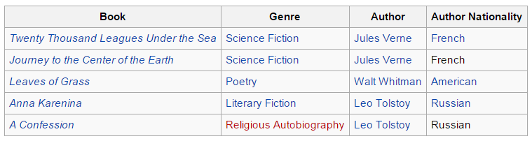
Transitive Dependency
A transitive dependency is a functional dependency which holds by virtue of transitivity. A transitive dependency can occur only in a relation that has three or more attributes.
The functional dependency {Book} → {Author Nationality} applies; that is, if we know the book, we know the author's nationality. Furthermore:
{Book} → {Author}
{Author} does not → {Book}
{Author} → {Author Nationality}
Therefore {Book} → {Author Nationality} is a transitive dependency.
Transitive dependency occurred because a non-key attribute (Author) was determining another non-key attribute (Author Nationality).

Slide 19
Decomposition
Solution to the problem caused by data redundancy and Functional Dependencies
Decomposition mean breaking up the large schema into multiple smaller schema
It help to remove all the anomalies and help to maintain data integrity
EMP_PROJ can be decomposed into following smaller schemas to remove update anomalies
EMP_PROJ
SSN
PNumber
Hours
EName
PName
PLocation
EMP
SSN
EName
PNumber
WORK_ON
SSN
PNumber
Hours
PROJECT
PNumber
PName
PLocation

Slide 20
Decomposition Problems
Decomposition may lead to its own problem
Following two properties of decomposition must be considered:
Loss less-join Property: Identify any instance (row) of original relation from the corresponding instance of the smaller relation attained after decomposition
Dependency preservation property: Ensures that each functional dependency is represented in some individual relation resulting after decomposition.

Slide 21
Normalization of Relations
Normalization is the process of decomposing relations with anomalies to produce smaller, well structured relations.
Normalization can be accomplished and understood in stages, each of which corresponds to a normal form.
Normal form is a state of a relation that results from applying simple rules regarding functional dependencies to that relation.
22

Slide 22
First Normal Form (1NF)
A relation is said to be in 1NF if:
The attribute value are atomic:
A attribute said to be value atomic if it contain only a single value of data for any given rows and column intersection
There should be No repeating group in particular rows
Relation in 1 NF disallows:
Multivalued attribute
Composite or nested attribute
Repeating groups of rows

Slide 23
First Normal Form (1NF)
Consider following DEPARTMENT relation
Multivalued

Slide 24
First Normal Form (1NF)
There are three main techniques to achieve first normal form for Multivalued attributes:
Expand the key so that there will be a separate tuple in the original DEPARTMENT relation for each location of a DEPARTMENT.
Decompose: Remove the attribute DLOCATIONS that violates 1NF and place it in a separate relation DEPT_LOCATIONS along with the primary key DNUMBER of DEPARTMENT.
If a maximum number of values is known for the attribute (e.g. 3) replace the DLOCATIONS attribute by three atomic attributes:
DLOCATION1, DLOCATION2, DLOCATION3.
Redundancy- Repeating groups
Null values
28

Slide 25
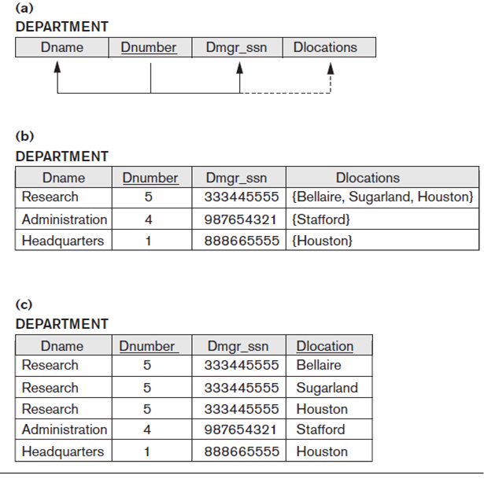
Multivalued
1- Expand PK
(a) A relation schema that is not in 1NF.
(b) Sample state of relation DEPARTMENT.
(c) 1NF version of the same
relation with redundancy-Repeating group -For each value of Dlocation group of (Dname, Dnumber, Dmgr_ssn) exists.
Introduce Repeating Group

Slide 26
DEPT_LOC
2- Decompose into 2 relation (DEPT_LOC, DEPT): to remove repeating group
New relation with Dnumber and Dlocation as PK
Dnumber | Dlocation
5 | Bellaire
5 | Sugarland
5 | Houston
4 | Stafford
1 | Houston
DEPT
Dname | Dnumber | Mng_ssn
Research | 5 | 333445555
Administration | 4 | 987654321
Headquarter | 1 | 888665555
DEPT_LOCATIONS
3- Three atomic locations
Dname | Dnumber | Mng_ssn | Dlocation1 | Dlocation2 | Dlocation3
Research | 5 | 333445555 | Bellaire | Sugarland | Houston
Administration | 4 | 987654321 | Stafford | Null | Null
Headquarter | 1 | 888665555 | Houston | Null | Null

Slide 27
First Normal Form (1NF)
Does not allow nested relations
Each tuple can have a relation within it
To change to 1NF:
Remove nested relation attributes into a new relation
Propagate the primary key into it
Un-nest relation into a set of 1NF relations

Slide 28
(a) Schema of the EMP_PROJ relation with a “nested relation” PROJS. (b) Example extension of the EMP_PROJ relation showing nested relations within each tuple.
First Normal Form (1NF)
Remove Nested Relation
(c) Decomposing EMP_PROJ into 1NF relations EMP_PROJ1 and EMP_PROJ2 by propagating the primary key (SSN).

Slide 29
Second Normal Form (2NF)
A relation is in 2NF if it is:
in 1NF
Every nonprime attribute is fully functionally dependent on the primary key
Remove Partial Dependency:
Any attributes which are dependent on part of the composite key
These attributes are put into a separate table along with that part of the compound key.
30

Slide 30
Second Normal Form: Examples
31

Slide 31
Second Normal Form: Examples (cont’d…)
{SSN, PNUMBER} → HOURS is a full FD since neither SSN → HOURS nor PNUMBER → HOURS hold
{SSN, PNUMBER} → ENAME is not a full FD (it is called a partial dependency )
since SSN → ENAME also holds
A relation schema R is in second normal form (2NF) if every non-prime attribute A in R is fully functionally dependent on the primary key
R can be decomposed into 2NF relations via the process of 2NF normalization

Slide 32
Example: Determine NF
In your solution you will write the following justification:
1) No M/V attributes, therefore at least 1NF
2) There is a partial dependency (Product_ID→Description), therefore not in 2NF
Product_ID → Description
Solution:
Order(Order_No, Prod_ID)
Prod(Prod_ID, Description)

Slide 33
Third Normal Form (3 NF)
Based on concept of transitive dependency
A Relations in third normal form (3NF) if it is in 2NF and there is no transitive dependency,
No non-prime attribute is dependent on another non-prime attribute
A relation is said to be in 3NF if every determinant is a key
i.e. for each and every fictional dependency: FD: A→B, A is a key
Solution: Decompose relation with attributes which are dependent on another attribute other than the primary key within the table.
32

Slide 34
Transitive Dependency
Transitive functional dependency – if there a set of atribute Z that are neither a primary or candidate key and both X → Y and Y → Z holds.
Examples:
SSN → DMGRSSN is a transitive FD since
SSN → DNUMBER and DNUMBER → DMGRSSN hold
SSN → ENAME is non-transitive since there is no set of attributes X where SSN → X and X → ENAME

Slide 35
Third Normal Form: Example
DNUMBER is non prime attribute which determine other non prime attribute DNAME and DMGRSSN
In other word SSN transitively (indirectly) determine DNAME and DMGRSSN
33

Slide 36
Example : Determine NF
ISBN → Title
ISBN → Publisher
Publisher → Address
In your solution you will write the following justification:
No M/V attributes, therefore at least 1NF
No partial dependencies, therefore at least 2NF
There is a transitive dependency (Publisher → Address), therefore, not 3NF
Solution:
Book( ISBAN,Title,Publisher)
Pub_Add(Publisher, Address)

Slide 37
Steps in Data Normalization
UNORMALISED ENTITY
Step 1: remove repeating groups
1st NORMAL FORM
Step 2: remove partial dependencies
2nd NORMAL FORM
Step 3: remove indirect dependencies
3rd NORMAL FORM
Step 4: remove multi-dependencies
Step 4: every determinate a key
4th NORMAL FORM
BOYCE-CODD NORMAL FORM
25

Slide 38
Advantages of Normalization
The amount of unnecessary redundant data is reduced.
Data integrity is easily maintained within the database.
The database & application design processes are much more flexible.
Security is easier to manage.
42

Slide 39
Disadvantages of Normalization
Produces lots of tables with a relatively small number of columns
Probably requires joins in order to put the information back together in the way it needs to be used
Impacts computer performance (CPU, I/O, memory).
43

